Slide 1
Which Positions in Football are valuable? And what will be most valuable in 2 years?
Hypothesis: If a player in a certain position is approaching 30 years old, they will be considered, everything being equal, past their prime.
Therefore, they will need replacement.
Are there certain positions in Football that are ageing?
If that is the case, then in two years time, the demand for that position will be high….

Slide 2
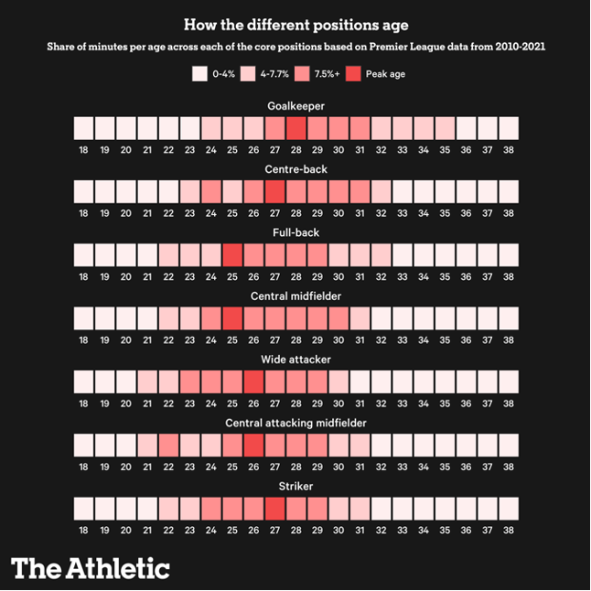
When do players peak?
Last 10 years of Premier League data
Based on player’s age at start of season, how many minutes did they play?
Divide minutes played per age category by total minutes played by all players in that position.

Slide 3
What does this show? Is it misleading?
• This simply shows which age category played the greatest number of minutes per position.
• Not necessarily indicative of quality just because clubs ‘trust them’ more.
• Goalkeepers tended to receive most of the minutes at an older age than other outfield positions in the Premier League.
• Other positions, such as Full Backs, is where younger players seemed to play more…
Tactical demands? – Energy and pace to go up and down flanks

Slide 4
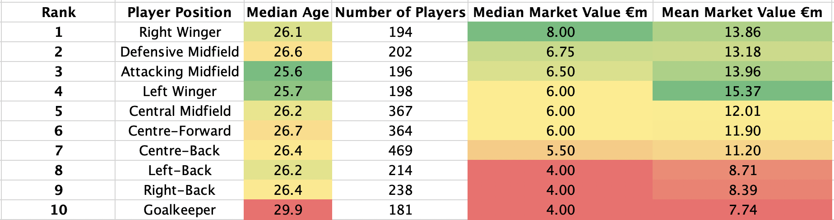
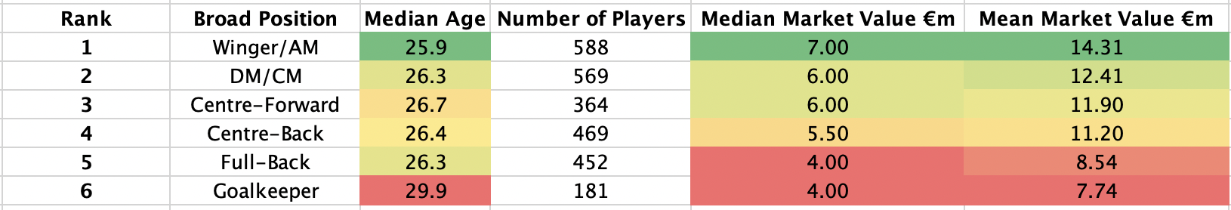
Top 5 European Leagues 2022/2023 Season: Age and Transfer Value by Position
Value Hierarchy
• Wingers, Central Midfielders, Centre-Forwards among the most valuable positions
• Then Centre-Backs
• Full-Backs and Goalkeepers least valuable

Slide 5
How does each league spend their money?
On what positions?
How many of them?
How much?

Slide 6
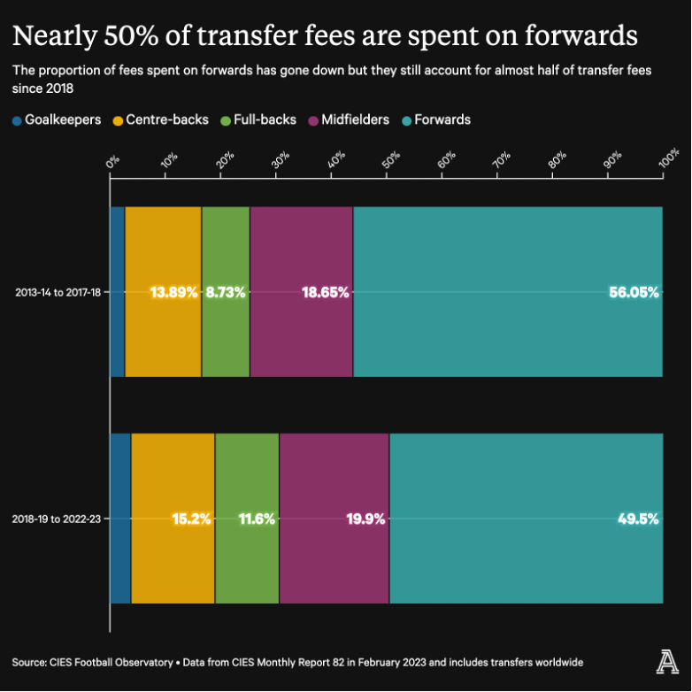
Explanation of Graph (CIES Report)
From 2013/14 season - 2017/18 season
Less than 3% (2.68%) of transfer fees were spent on GK
13.89% on CB’s, 8.73% FB’s, 18.65% MF, 56.05% FW’s (Wingers + ST)
From 2018/19 to 2022/23 Season
3.8% on GK, 15.2% CB, 11.6% FB, 19.9% MF, 49.5% FW (Wingers + ST)

Slide 7
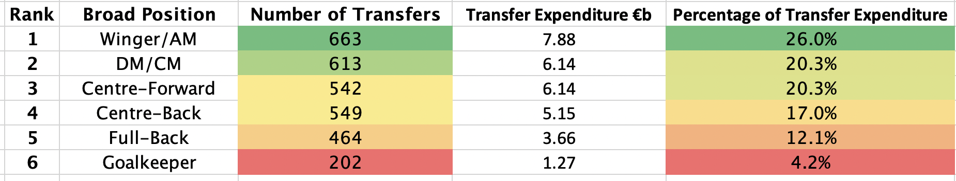
Validated Data
Based on 2017/2018 – 2022/2023 Top 5 European Leagues
GK: 4.2%
FB: 12.1%
CB: 17%
DM/CM: 20.3%
FW: 46.3%
Key:
AM: Attacking Midfielder
DM/CM: Defensive or Central Midfielder

Slide 8
However!
You cannot in isolation look at % of transfer fees spent.
Can you really compare FB’s with GK’s?
Fullbacks include both RB and LB, so the percentages should be halved?
Same can be applied for FW’s (includes ST, RW, LW)
• ‘Squad Building Affect’: There is much higher physical load on an outfielder -> more need for quality back ups -> more of a need for transfers!
• We need something a bit more granular….

Slide 9
In this Presentation we will explore…
Based on the last six seasons of data
How many of each position was transferred?
What was the greatest fee of each position group?
What was the mean and median transfer fee of each position group?
Did this change over time?
Do certain leagues prefer or have tendencies to spend more on a certain position?

Slide 10


Slide 11
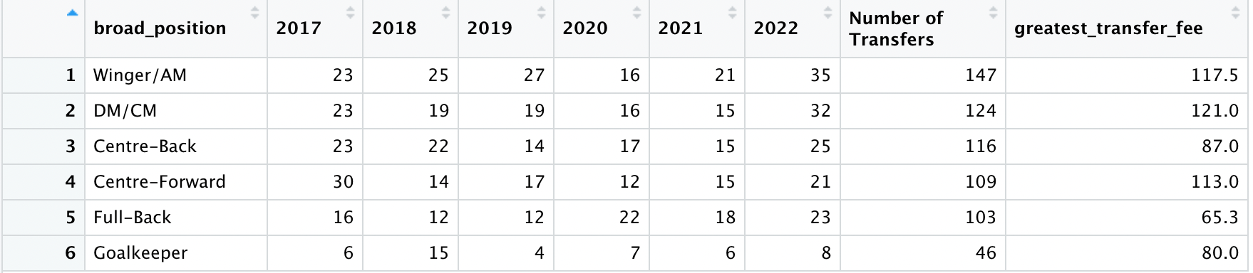
Premier League Transfers by Position Last 6 seasons: 2017/18 – 2022/2023 Number of Transfers
Fee in €m
90 | 144 | 645
Total | 121 | 107 | 93 | 90
Key:
AM: Attacking Midfielder
DM/CM: Defensive or Central Midfielder
Insights:
• Number of transfers highest last season in last six years
• Wingers/AM transferred in the most, Goalkeepers the least
(46/147 = 31%) of Winger /AM transfers
• Highest fee of Goalkeeper more than 66% (80/121) of that of the highest category

Slide 12
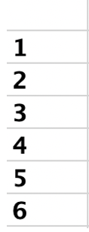
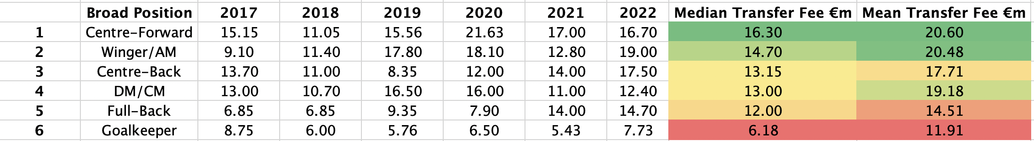
Premier League Transfers by Position Last 6 seasons: 2017/18 – 2022/2023 Median Transfer Fee per Position
Insights:
• Centre-Forwards the most expensive players followed by Wingers/AMs
• Then Midfielders and Centre-Backs, then Fullback’s, then Goalkeepers.
• GK around 38% of highest median transfer (6.18/16.30)
and 59% (11.91/20.60) of highest mean transfer
Key:
AM: Attacking Midfielder
DM/CM: Defensive or Central Midfielder

Slide 13
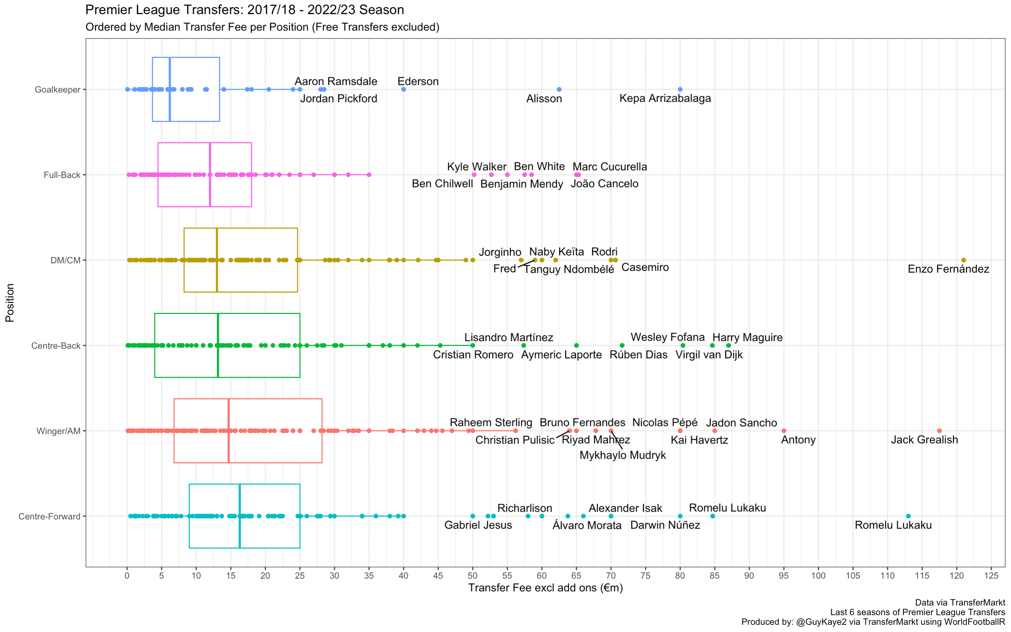

Slide 14
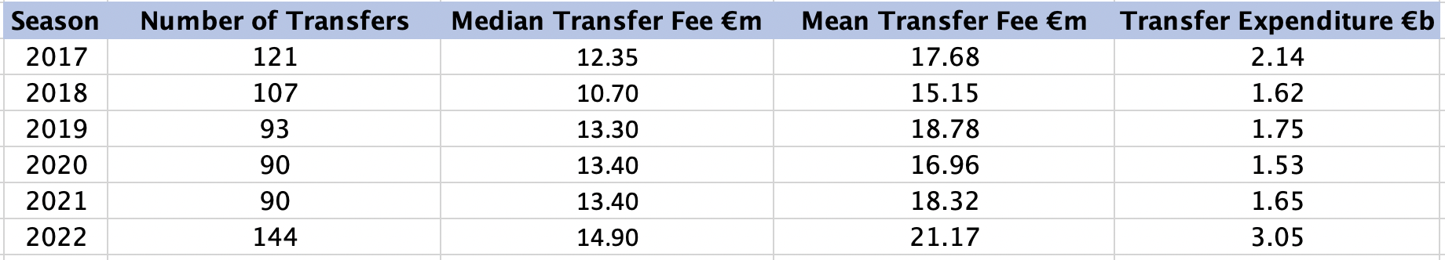
PL Overview
Insight:
• Last season highest for both mean and median transfer fee
• Last season (2022) also had the greatest number of transfers (incomings) and total expenditure

Slide 15
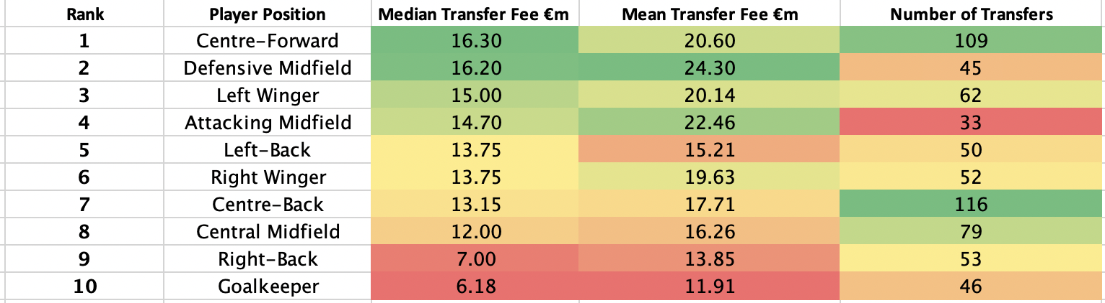
Focusing on specific positions
LEFT SIDE FAVORITISM!
Insights:
• CF’s and DMs went for the most amount of money (DMs>CMs)
• LB and LW went for more money than RB and RW
• CB’s the most transferred in position followed by CF’s
Note:
Last 6 seasons of PL Transfers (Incomings)

Slide 16
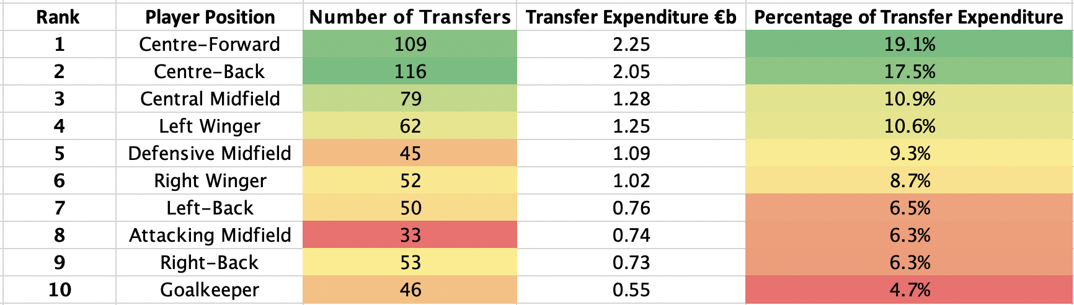
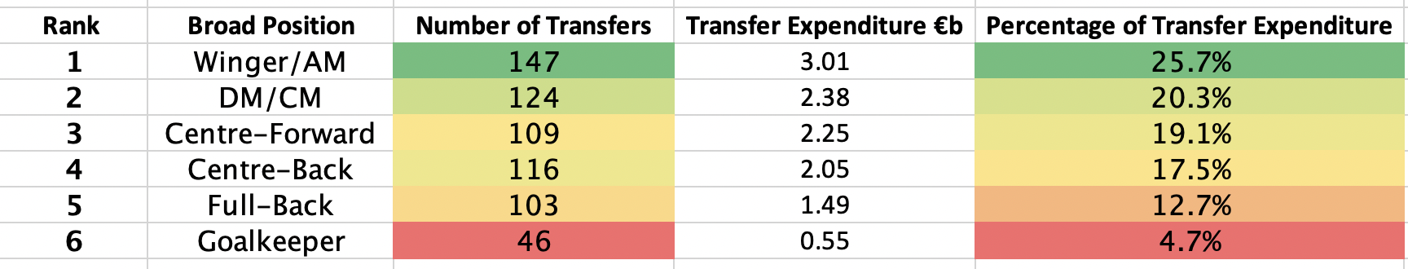
Focusing on specific positions
Insight: GK only accounted for just under 5% of transfer expenditure.
More of an even spread of percentage of expenditure although more 'attacking’ players favored in general

Slide 17


Slide 18
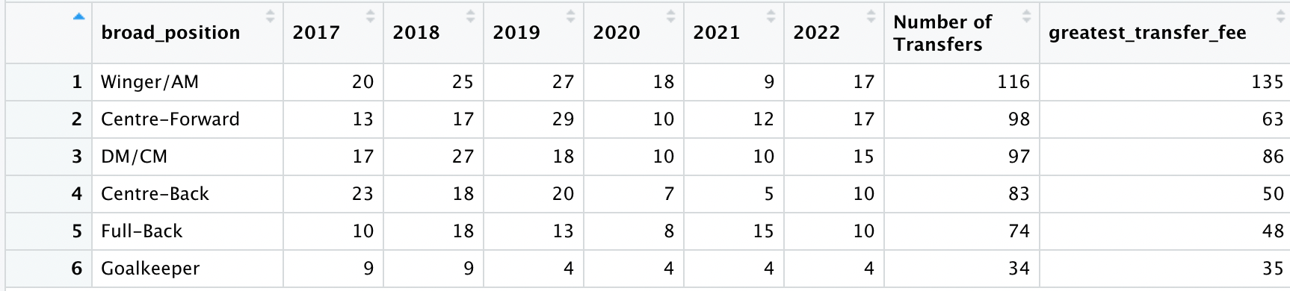
La Liga Transfers by Position Last 6 seasons: 2017/18 – 2022/2023 Number of Transfers
55 | 73 | 502
Total | 92 | 114 | 111 | 57
Key:
AM: Attacking Midfielder
DM/CM: Defensive or Central Midfielder
Insights:
• Wingers/AM transferred in the most, Goalkeepers the least (similar to the PL)

Slide 19
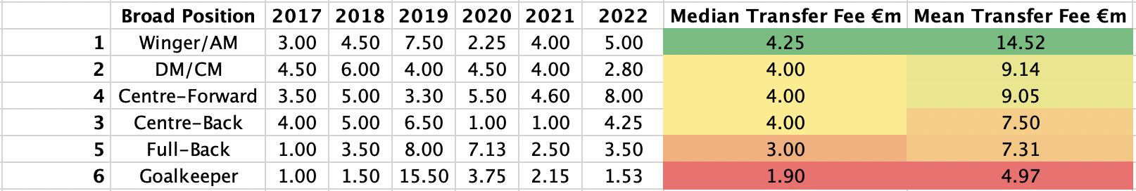
La Liga Transfers by Position Last 6 seasons: 2017/18 – 2022/2023 Median Transfer Fee per Position
Insights:
• Wingers/AM the most expensive players followed by DM/CM and CF’s
• Then CB’s, then FB’s, then GK
(Similar trend to the PL if you reverse CF and Winger/AM)
• GK around 45% of highest median transfer (1.90/4.25)
and 34% (4.97/14.52) of highest mean transfer
Key:
AM: Attacking Midfielder
DM/CM: Defensive or Central Midfielder
Key:
AM: Attacking Midfielder
DM/CM: Defensive or Central Midfielder

Slide 20
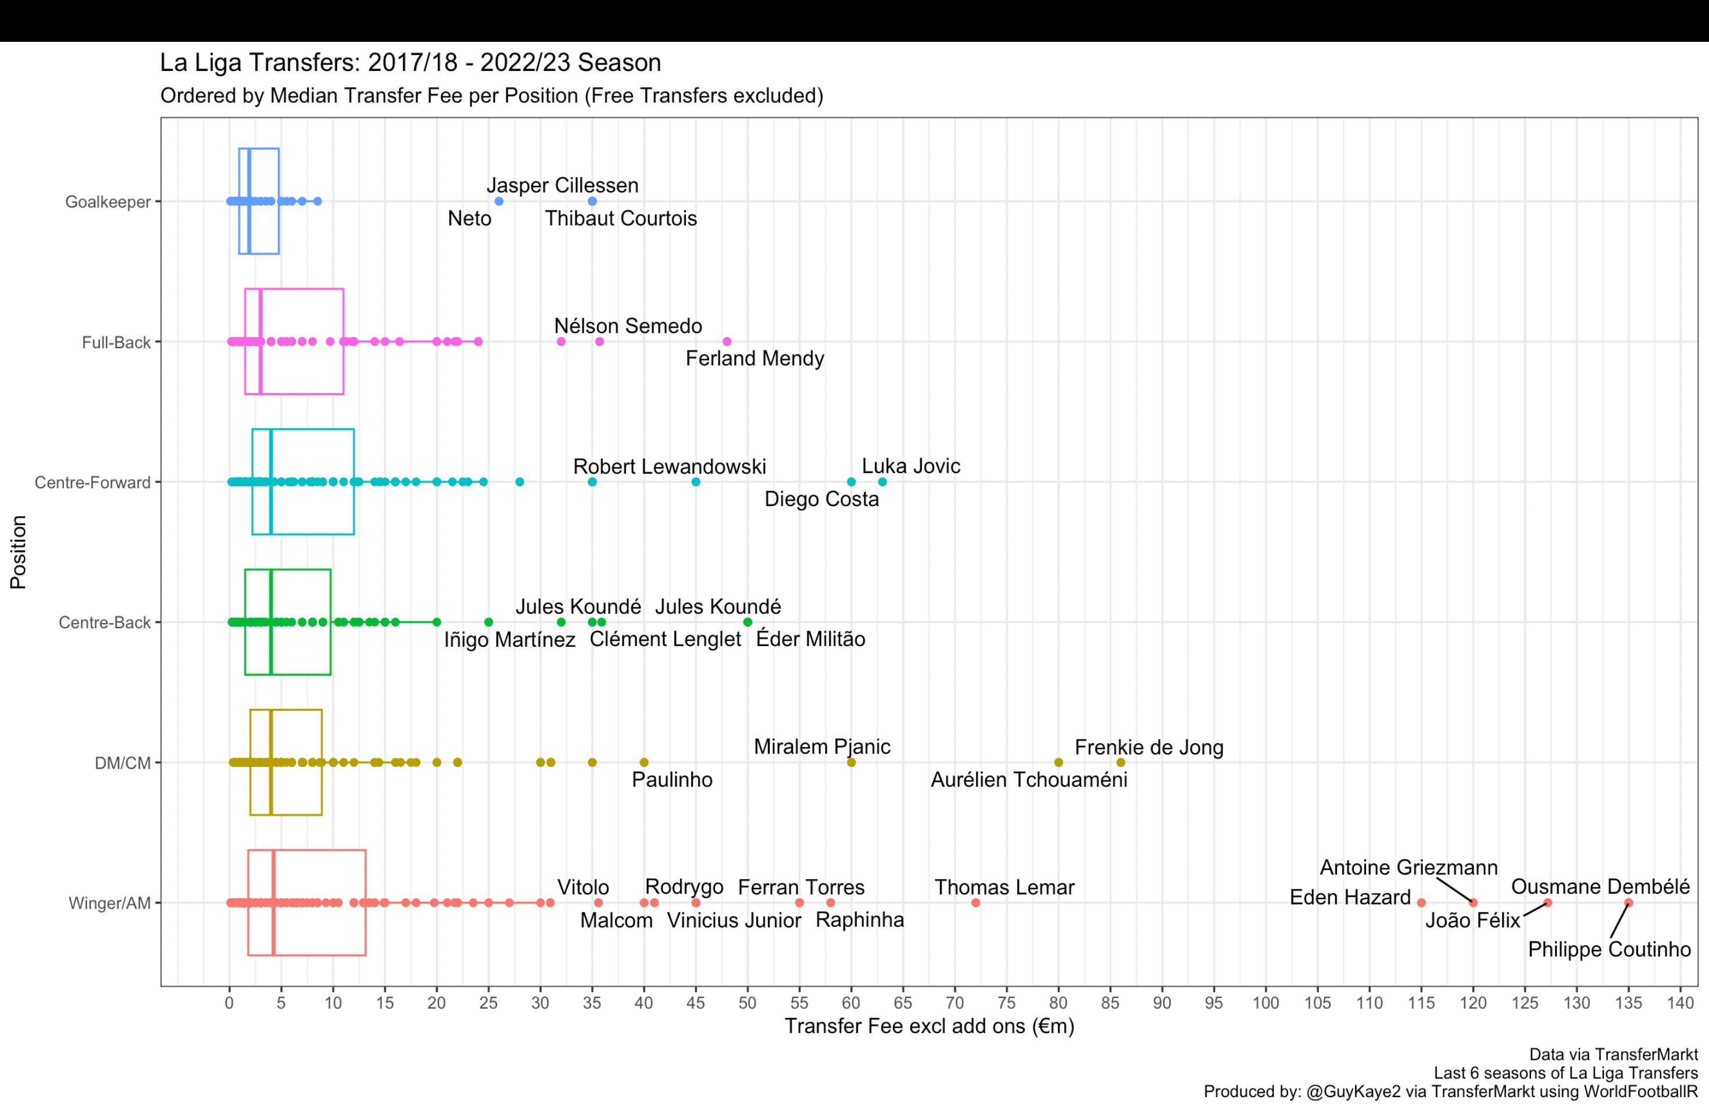

Slide 21
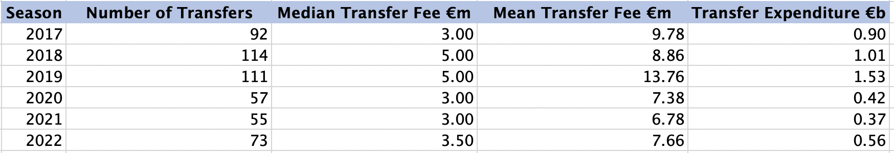
La Liga Overview
Insight:
• Number of transfers drop in 2020 as well as median/mean transfer fee and expenditure
• However, 2022 indicates recovery in all metrics (# Transfers, median/mean transfer fee and expenditure)

Slide 22
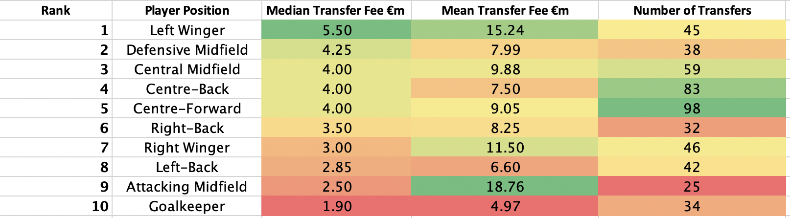
Focusing on specific positions
Insights:
• Left Wingers went for the most amount of money (median)
• Wingers (LW>RW) but FBs (RB>LB)
• GK least valuable
• CF’s the most transferred in position with CB’s second (flipped in the PL)
Note:
Last 6 seasons of La Liga Transfers (Incomings)

Slide 23
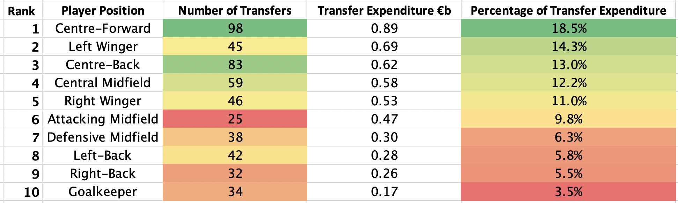
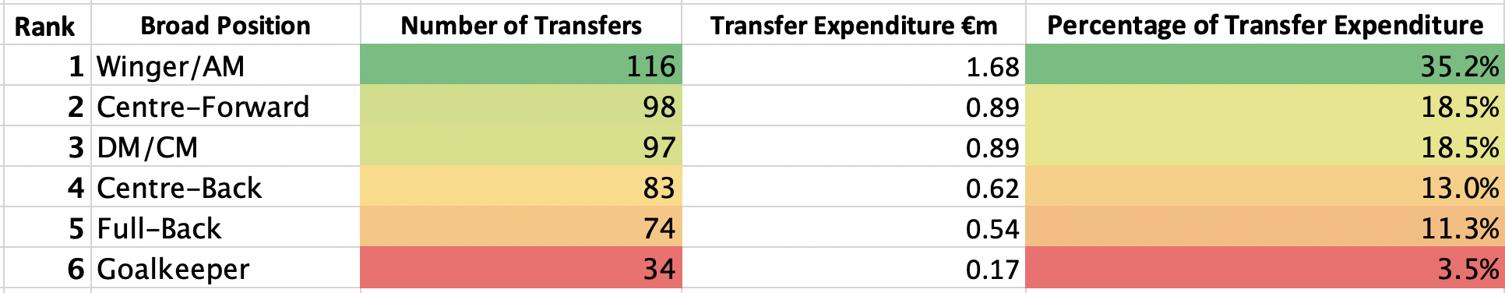
Focusing on specific positions
Insight: GK only accounted for 3.5% of transfer expenditure
Similar to PL but a bit less of an even spread (more expenditure on Wingers/AM) with less on defensive players

Slide 24


Slide 25
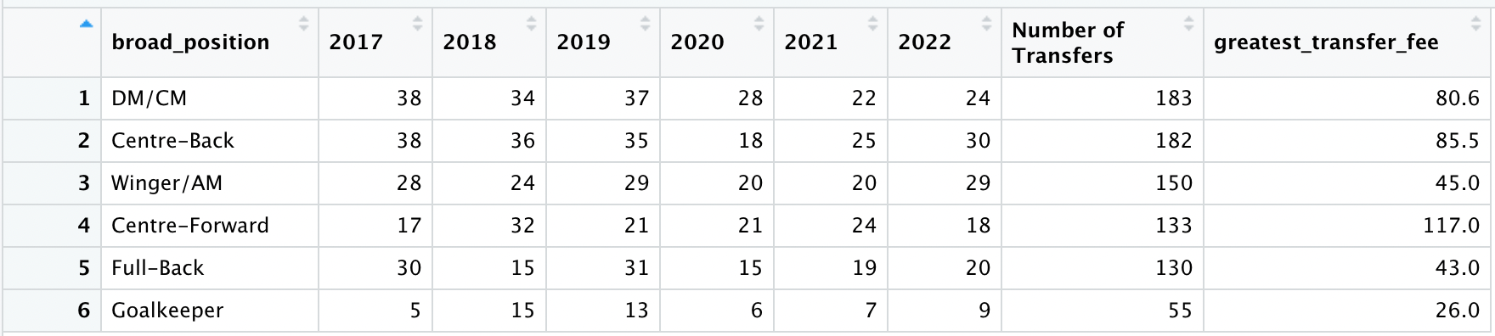
Serie A Transfers by Position Last 6 seasons: 2017/18 – 2022/2023 Number of Transfers
117 | 130 | 833
Total | 156 | 156 | 166 | 108
Insights:
• Winger/AM no longer most transferred in position (Midfielders and CBs)
Goalkeepers the least
Key:
AM: Attacking Midfielder
DM/CM: Defensive or Central Midfielder

Slide 26
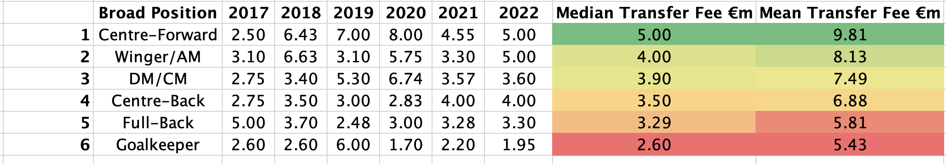
Serie A Transfers by Position Last 6 seasons: 2017/18 – 2022/2023 Median Transfer Fee per Position
Insights:
• CF’s the most expensive players followed by Winger/AM and DM/CM
• Then CB’s, then FB’s, then GK
(Very similar to PL and La Liga)
• GK 52% of highest median transfer (2.6/5.0)
and 55% (5.43/9.81) of highest mean transfer
Key:
AM: Attacking Midfielder
DM/CM: Defensive or Central Midfielder

Slide 27
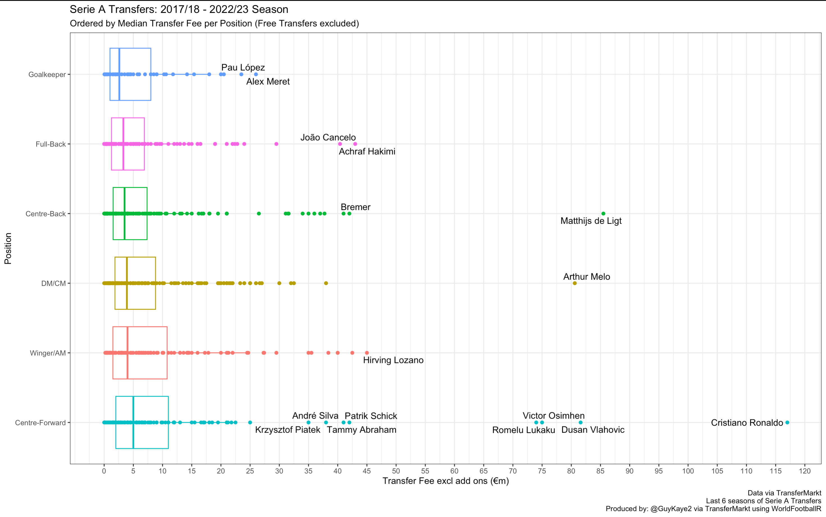

Slide 28
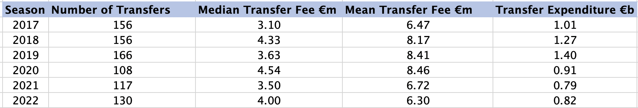
Serie A Overview
Insight:
• Number of transfers drop in 2020 as well as expenditure, further drop in 2021. Same COVID pandemic affect.
• However, 2022 indicates recovery in all metrics (# Transfers, median/mean transfer fee and expenditure)

Slide 29
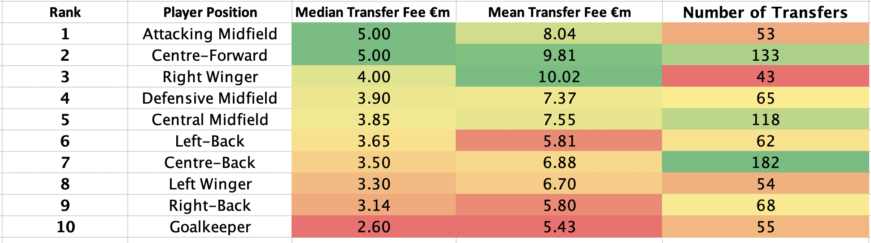
Focusing on specific positions
Insights:
• Attacking midfielders and CF’s went for the most amount of money (median)
• Wingers (RW>LW) but FBs (LB>RB) in value
• GK least valuable
• CB’s the most transferred in position followed by CF (same as PL)
Note:
Last 6 seasons of Serie A Transfers
(Incomings)

Slide 30
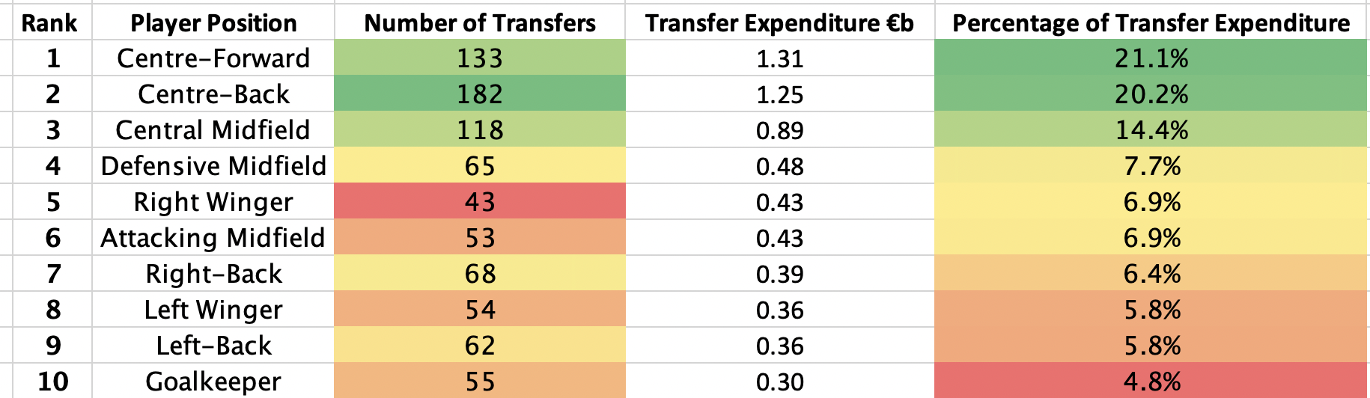
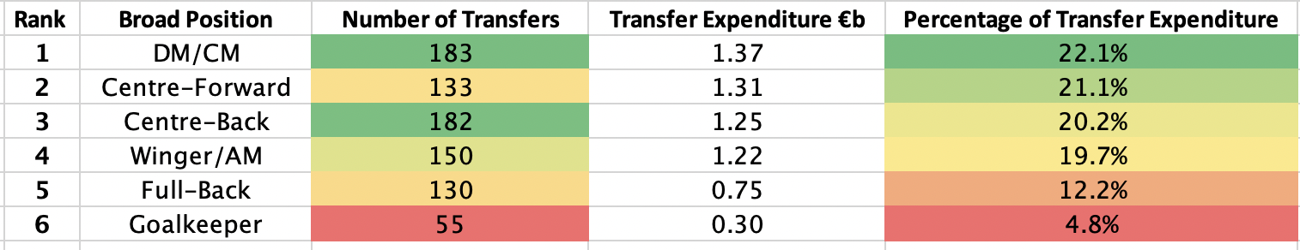
Focusing on specific positions
Insight: DM/CM and CB’s most
transferred in position
Insight: GK only accounted for 4.8% of transfer expenditure
More even spread of expenditure. GK and FB least but rest very even.

Slide 31


Slide 32
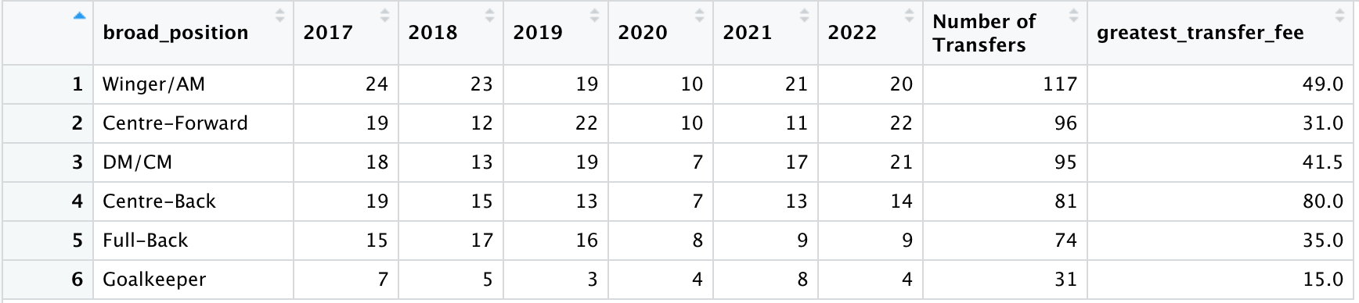
Bundesliga Transfers by Position Last 6 seasons: 2017/18 – 2022/2023 Number of Transfers
79 | 90 | 494
Total | 102 | 85 | 92 | 46
Insights:
• Wingers/AM transferred in the most, Goalkeepers the least
(31/117 = 26%)
Key:
AM: Attacking Midfielder
DM/CM: Defensive or Central Midfielder

Slide 33
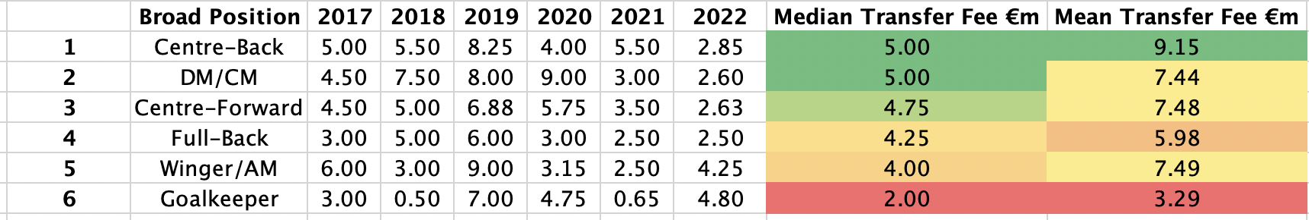
Bundesliga Transfers by Position Last 6 seasons: 2017/18 – 2022/2023 Median Transfer Fee per Position
Insights:
• Significant trend change: CB’s the most expensive players followed by DM/CM
and CF
• Wingers/AM uniquely not transferred for as much into the Bundesliga
Full-Backs went (based on median) for more money
• GK 40% of highest median transfer (2/5)
and 36% (3.29/9.15) of highest mean transfer
Key:
AM: Attacking Midfielder
DM/CM: Defensive or Central Midfielder

Slide 34
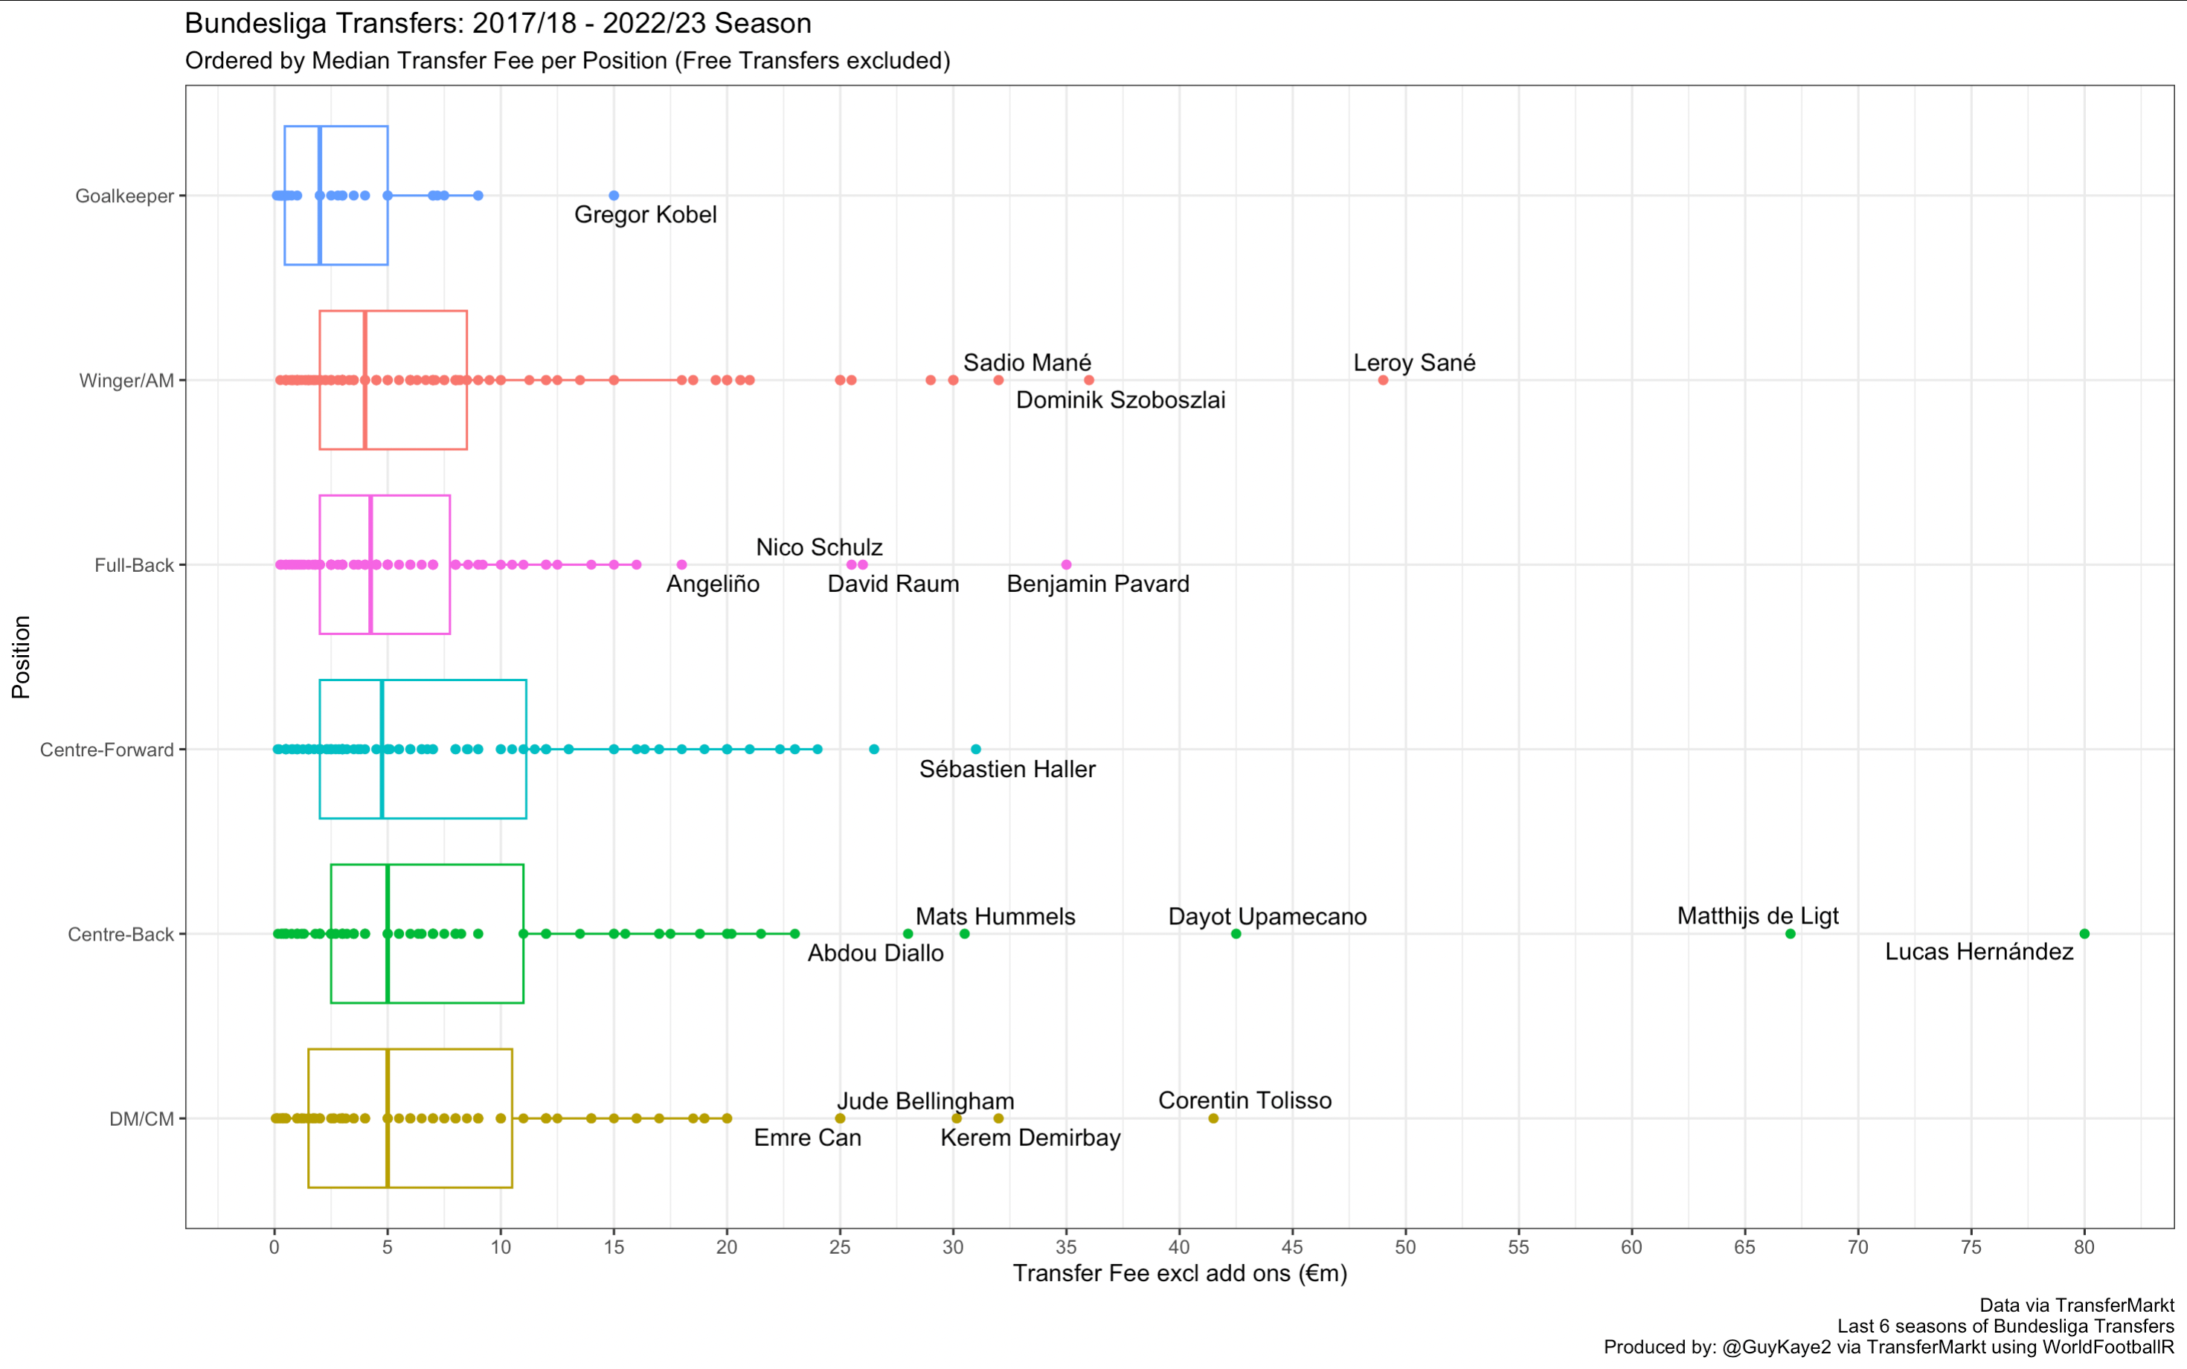

Slide 35
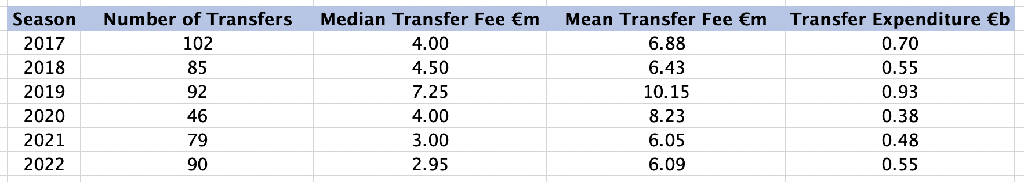
Bundesliga Overview
Insight:
• Number of transfers drop in 2020 as well as expenditure, further drop in 2021. Same COVID pandemic affect.
• 2022 recovery in # Transfers, and expenditure, but median transfer fee lowest in last six seasons

Slide 36
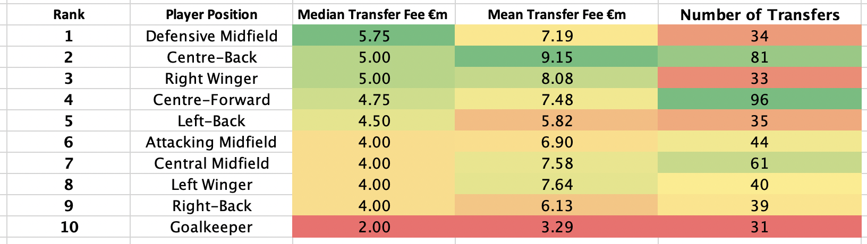
Focusing on specific positions
Insights:
• Defensive midfielders and CBs went for the most amount of money (median)
• (RW>LW) in value but not for full-backs
• GK least valuable
• CFs the most transferred in position with CB’s second (like Serie A)
Note:
Last 6 seasons of Bundesliga Transfers
(Incomings)

Slide 37
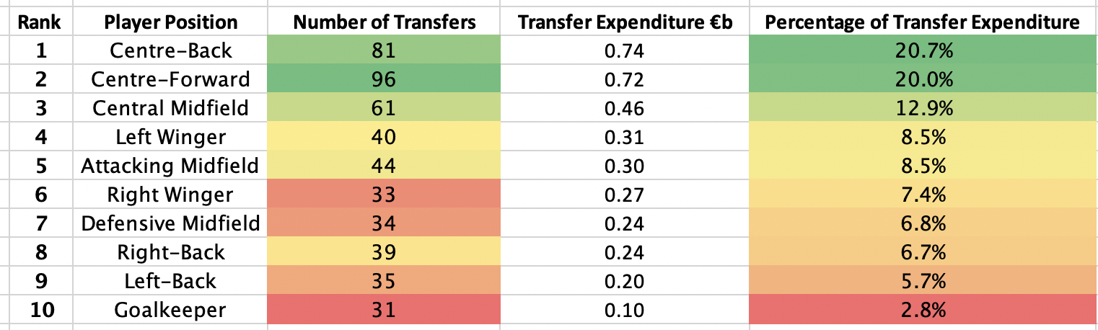
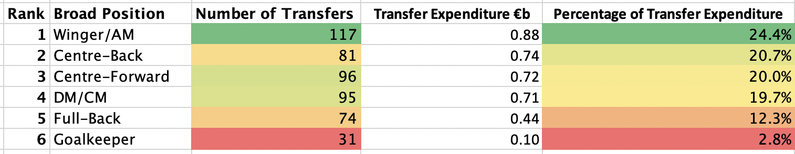
Focusing on specific positions
Even distribution

Slide 38


Slide 39
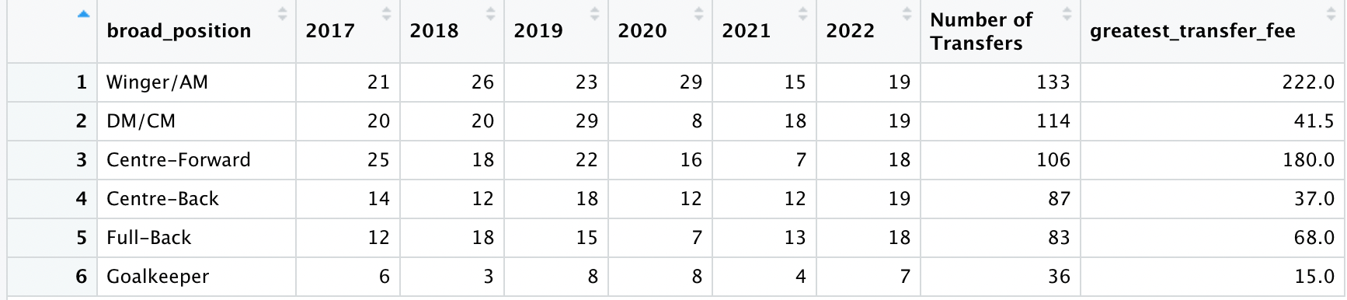
Ligue 1 Transfers by Position Last 6 seasons: 2017/18 – 2022/2023 Number of Transfers
69 | 100 | 559
Total | 98 | 97 | 115 | 80
Key:
AM: Attacking Midfielder
DM/CM: Defensive or Central Midfielder

Slide 40
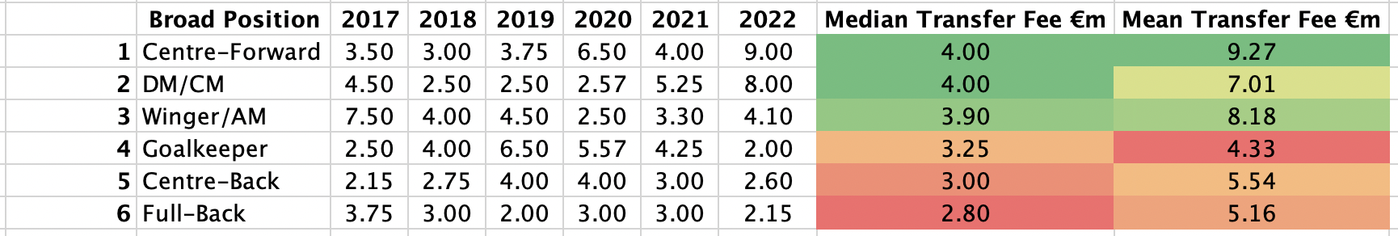
Ligue 1 Transfers by Position Last 6 seasons: 2017/18 – 2022/2023 Median Transfer Fee per Position
Insights:
• Significant trend change: Goalkeepers no longer the least valued position
• Full-Back deemed the least valuable position (median)
Key:
AM: Attacking Midfielder
DM/CM: Defensive or Central Midfielder

Slide 41
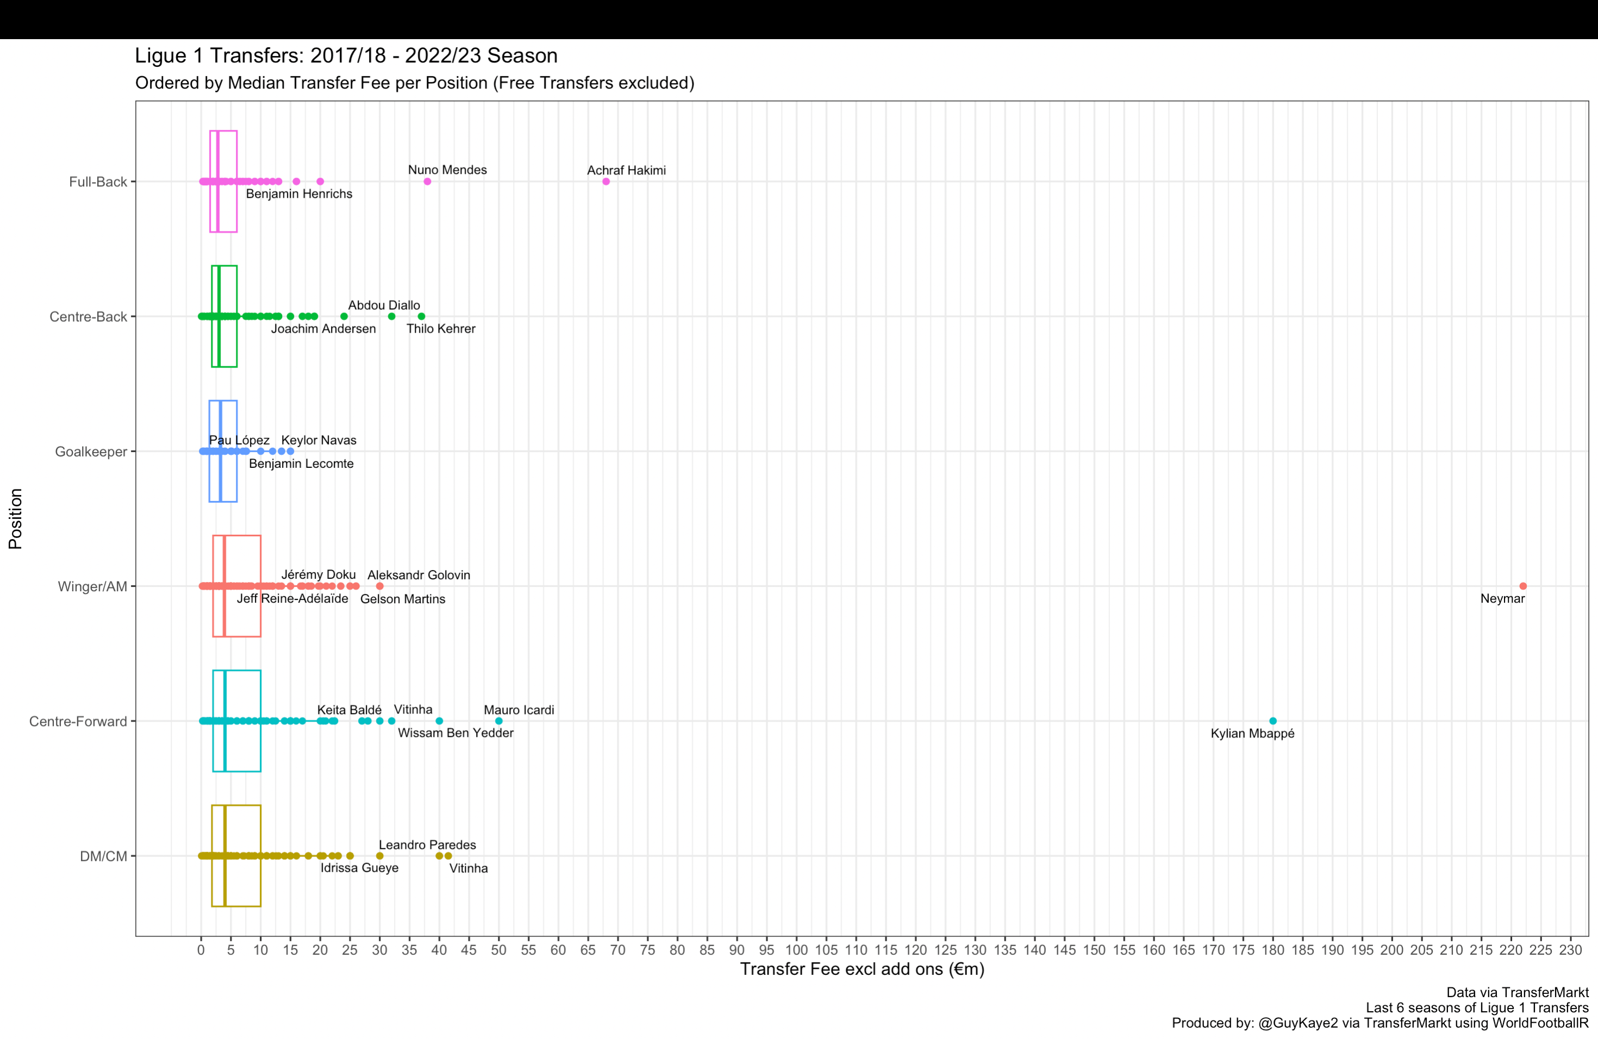

Slide 42
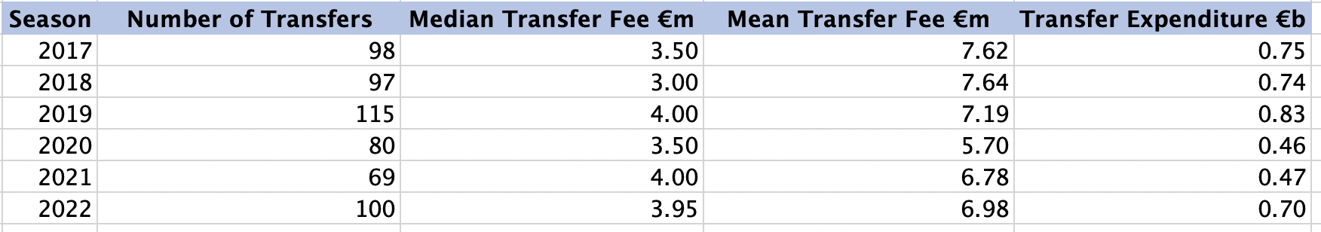
Ligue 1 Overview
Insights:
Similar COVID affecting drop off in number of transfers and expenditure

Slide 43
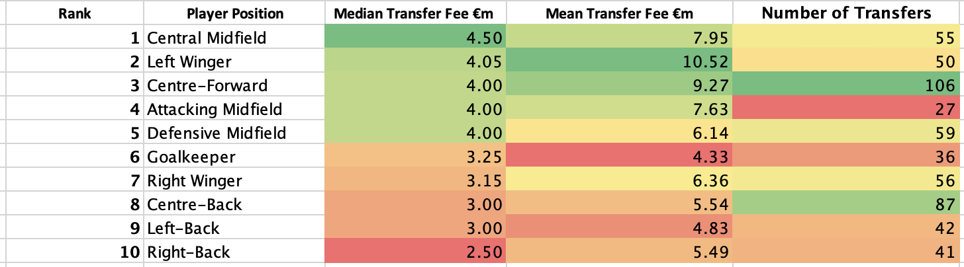
Focusing on specific positions
Left Wingers more valuable than Right Wingers

Slide 44
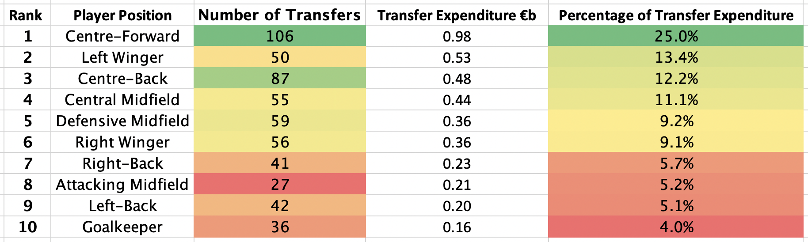
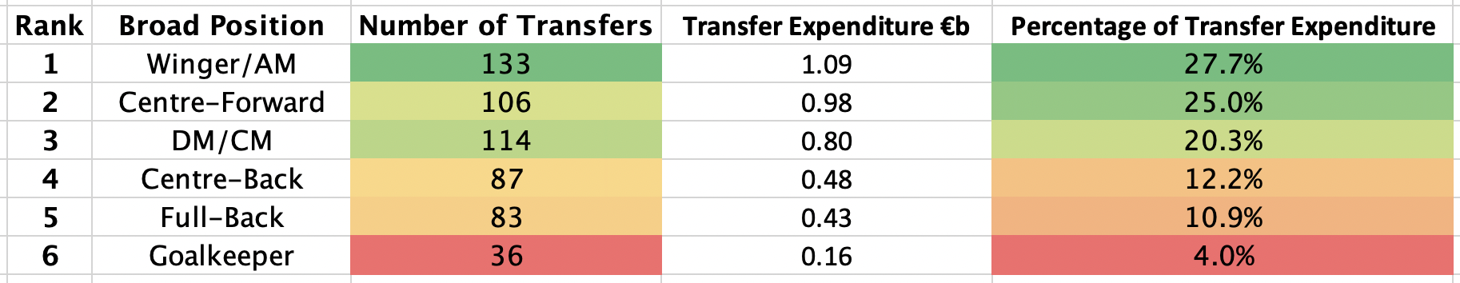
Focusing on specific positions

Slide 45

COMBINED BIG 5 EUROPEAN LEAGUES

Slide 46
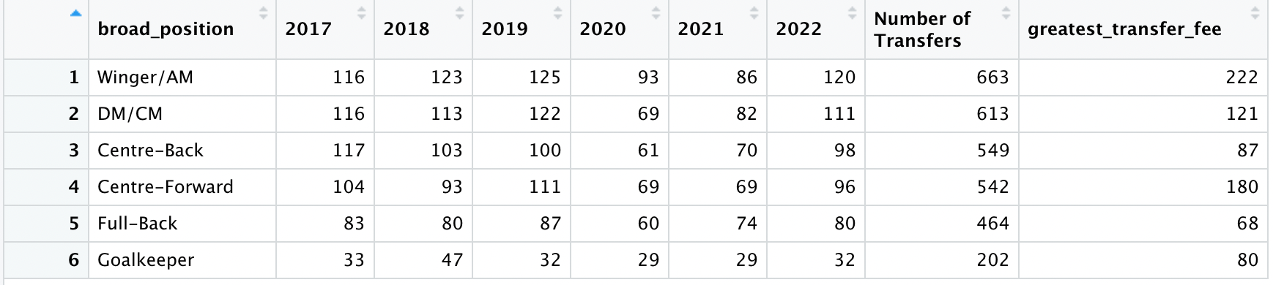
Top 5 EU Leagues: Transfers by Position Last 6 seasons: 2017/18 – 2022/2023 Number of Transfers
Wingers/AM most transferred in group
Goalkeepers the least
Key:
AM: Attacking Midfielder
DM/CM: Defensive or Central Midfielder

Slide 47
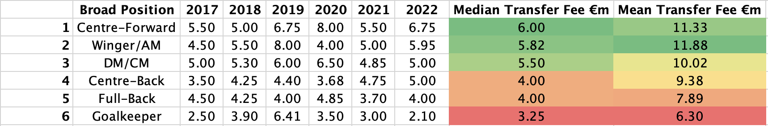
Top 5 EU Leagues: Transfers by Position Last 6 seasons: 2017/18 – 2022/2023 Median Transfer Fee per Position
Trend most similar to the PL:
• Centre-Forward the most valuable position closely followed by Wingers/AM and then Midfielders
• Then Centre-Backs and Full-Backs, then Goalkeepers
Key:
AM: Attacking Midfielder
DM/CM: Defensive or Central Midfielder

Slide 48
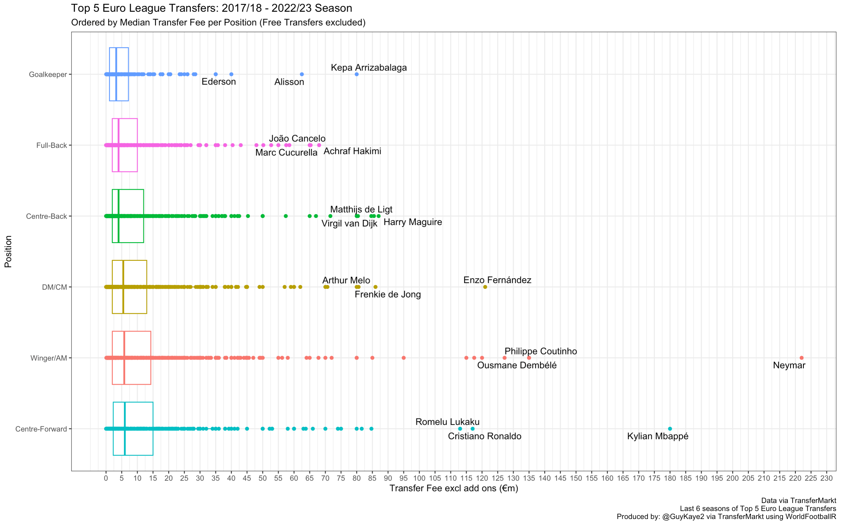

Slide 49
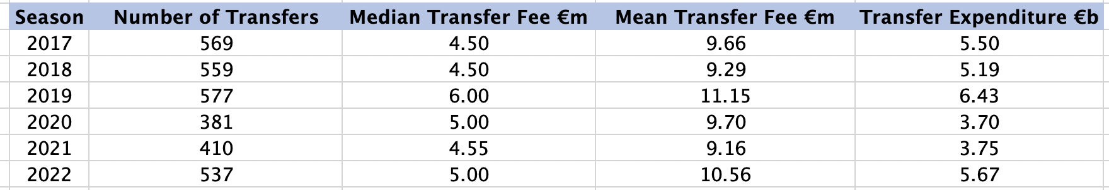
Top 5 League Overview
Same COVID affect

Slide 50
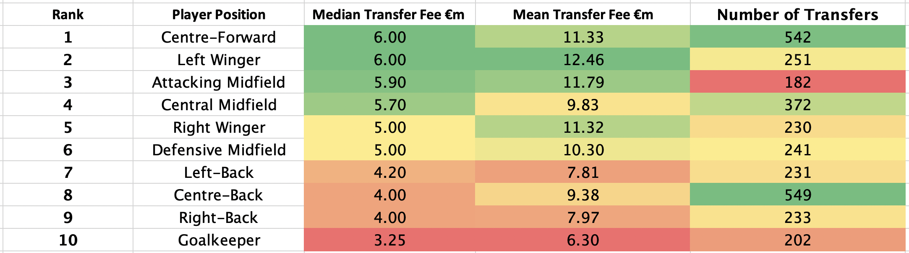
Focusing on specific positions
Attacking players are the most valuable positions
Left Wingers more valuable than Right Wingers

Slide 51
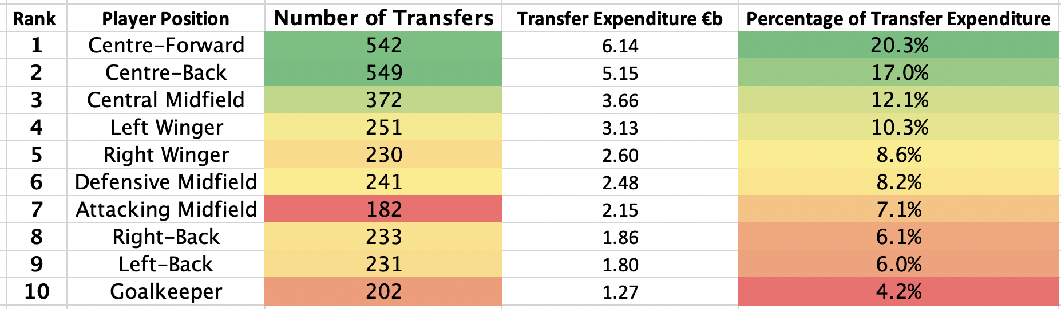
Focusing on specific positions

Slide 52
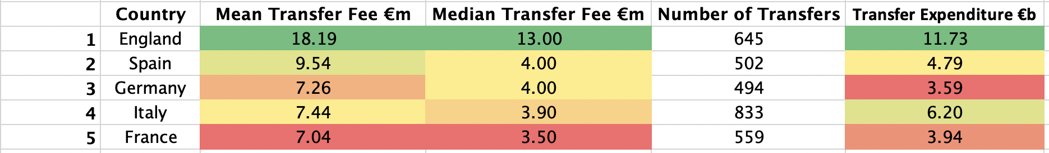
The English Premier League is a Super League…
Based on Transfer Incomings over the last six seasons (2017/2018 – 2022/2023)
Data: TransferMarkt
By: @GuyKaye2

Slide 53
Conclusion of European Leagues
League | Most Transferred in Category | Most Transferred in Position | Most Expensive Category (median) | Most Expensive Position (median) | Cheapest Category (median)
Premier League (ENG) | Winger/AM | CB, then CF | CF | CF and DM | GK
La Liga (SPA) | Winger/AM | CF, then CB | Winger/AM | LW | GK
Serie A (ITA) | DM/CM and CB | CB, then CF | CF | AM and CF | GK
Bundesliga (GER) | Winger/AM | CF, then CB | CB, DM/CM | DM | GK
Ligue 1 (FRA) | Winger/AM | CF, then CB | CF, DM/CM | CM | FB
Combined (EU) | Winger/AM | CB, then CF | CF | CF and LW | GK

Slide 54
Conclusion
Most Valuable Position in 2 years?
- It is a very difficult question to answer
Different Clubs will have different requirements based on the profile and characteristics of their squad
However, we can see empirically that the demand for younger players is increasing
• Attacking players are deemed more valuable at present than Defenders/Goalkeepers – but this does not mean that the latter are worthless
• Rise of ball playing Goalkeepers, Left-footed CB’s, Complete Full-Backs, Complete Strikers, All Action Midfielders

Slide 55
Conclusion continued
Premier League represents by far the biggest market in terms of value and volume of transfers
Premier League is most similar relatively to La Liga and Serie A in terms of how different positions are valued.
Centre-Forward’s most expensive, then Wingers/Attacking Midfielders, then Central Midfielders and Centre-Back’s, then Full-Back’s, then Goalkeeper’s.
• Bundesliga an outlier on how positions are valued
Centre-Back’s and Central Midfielder’s most valuable
• Ligue 1
- Goalkeeper’s no longer the least valuable position (median transfer fee)

